Slide 1
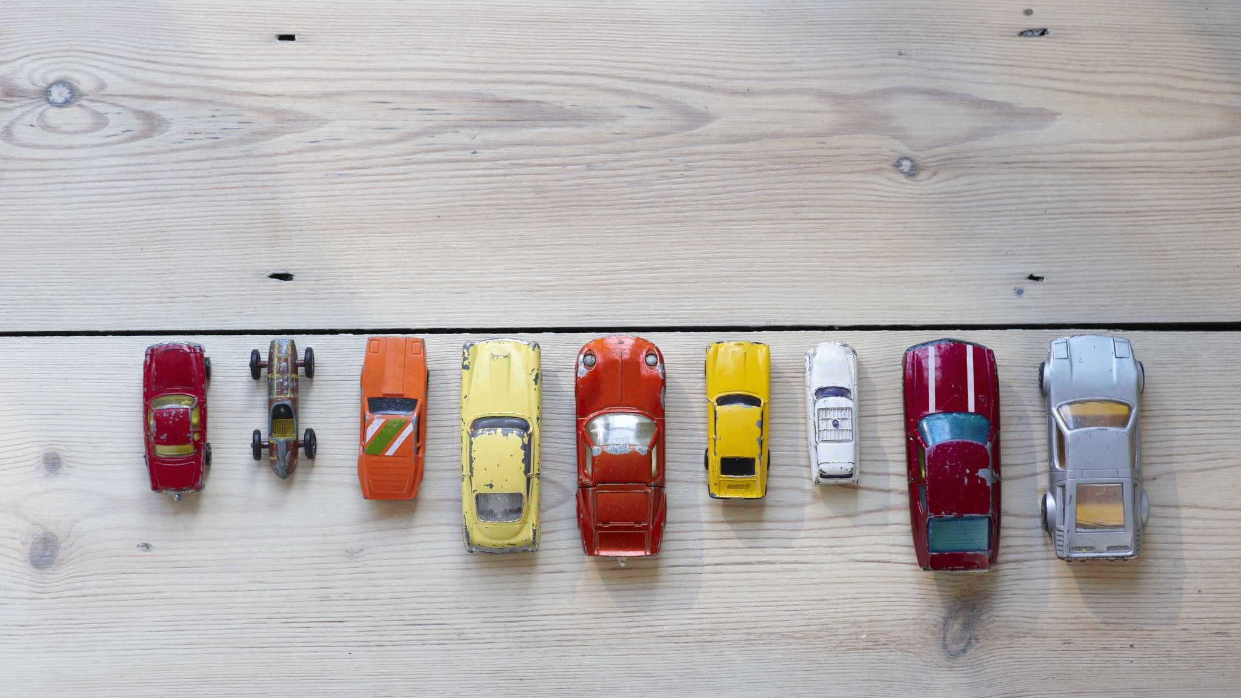
Predictive Modeling on Used cars

Slide 2
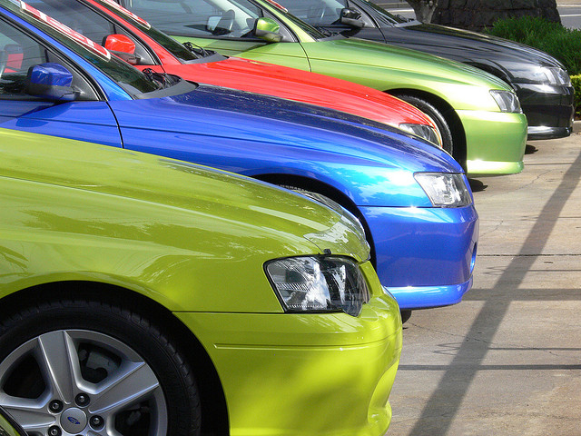
USED CARS

Slide 3
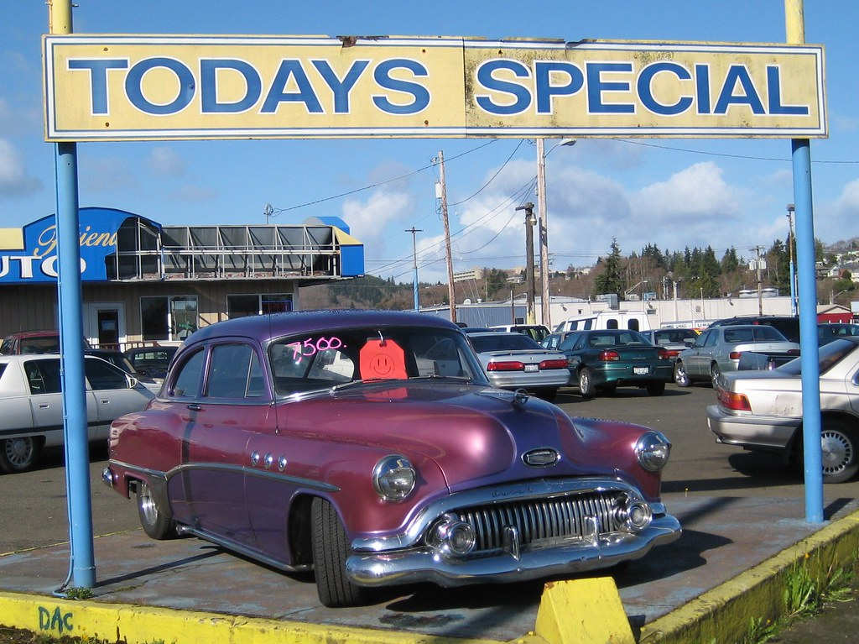

Key Questions
How various aspects of a vehicle affect how much used automobiles cost?
What certain key trends can assist in predicting future market prices more accurately than relying on yearly averages of all car values combined.?

Slide 4

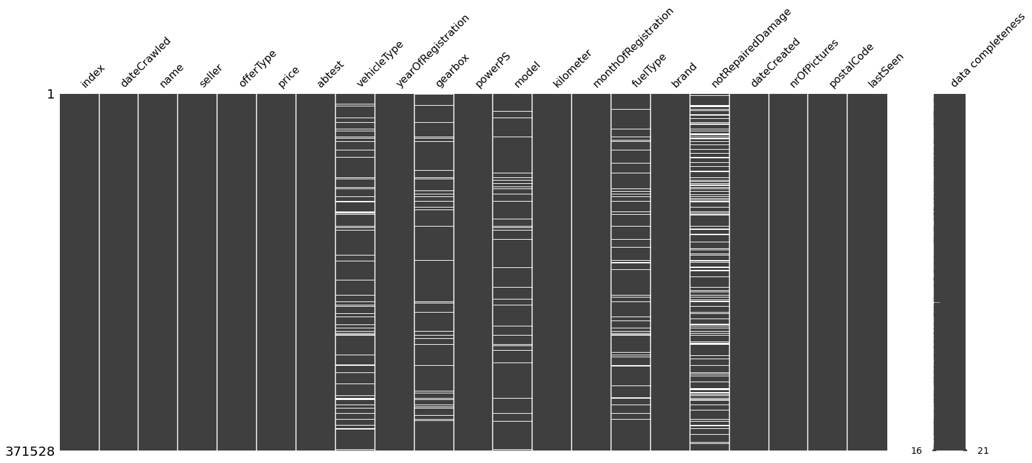
📊Intro to EDA
Shape & Null values info
Since the percentage of null values in each column are less than 50% of total data, we decided to drop them.
Null values percentage
Shape of the dataset | (300, 21)
Null value columns | ["vehicleType","gearbox","model","fuelType","notRepairedDamage"]
Jagged lines represent the number of null values present in that particular column

Slide 5
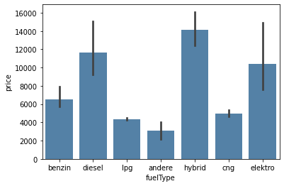
Price VS Fuel Type
This bar graph represents the Fuel type and its price.
Among these different types, hybrid has the highest price range.
Andere has the lowest price range among 7 other fuel types.

Slide 6
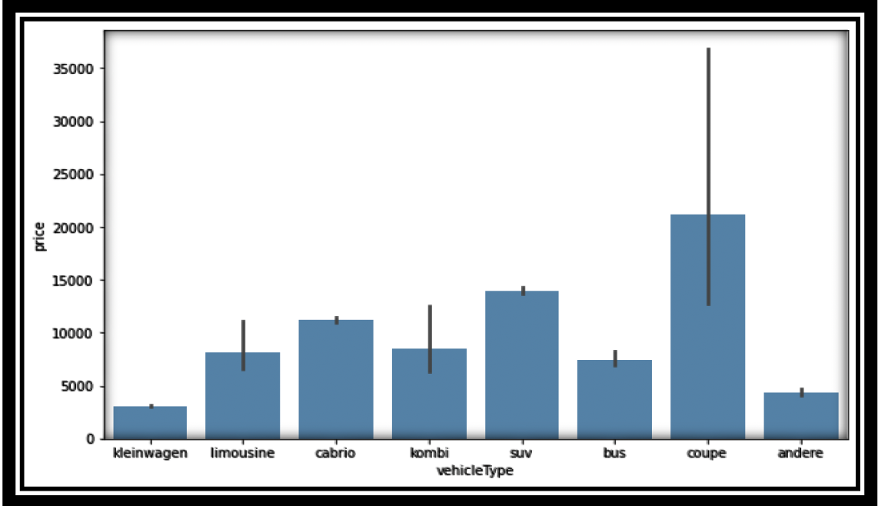
Price VS Vehicle Type
This bar graph represents the vehicle type and its price.
Among these different types, Coupe has the highest price range.
Klein Wagen has the lowest price range among 8 other vehicle types.

Slide 7
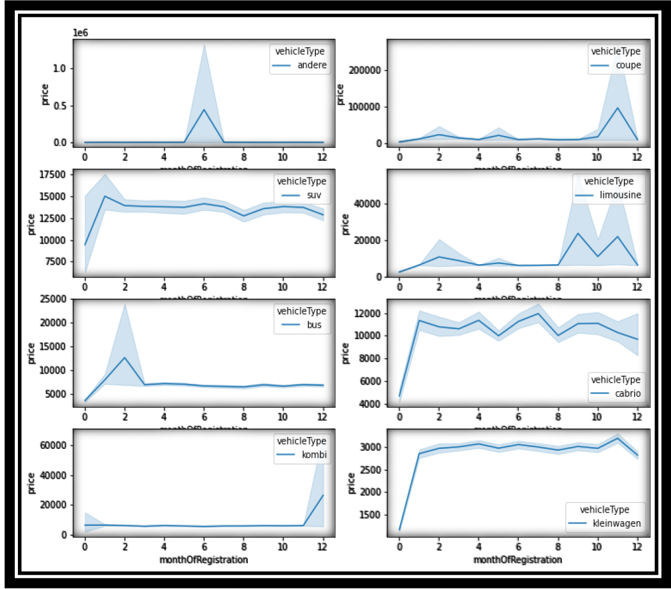
Price VS Month
Between August and December, we can infer that prices for Coupe and Limousine have increased significantly.
Rest of the car types such as compact, cabriolets, SUVs and Kombis have their prices mostly in a constant range through out the year.

Slide 8
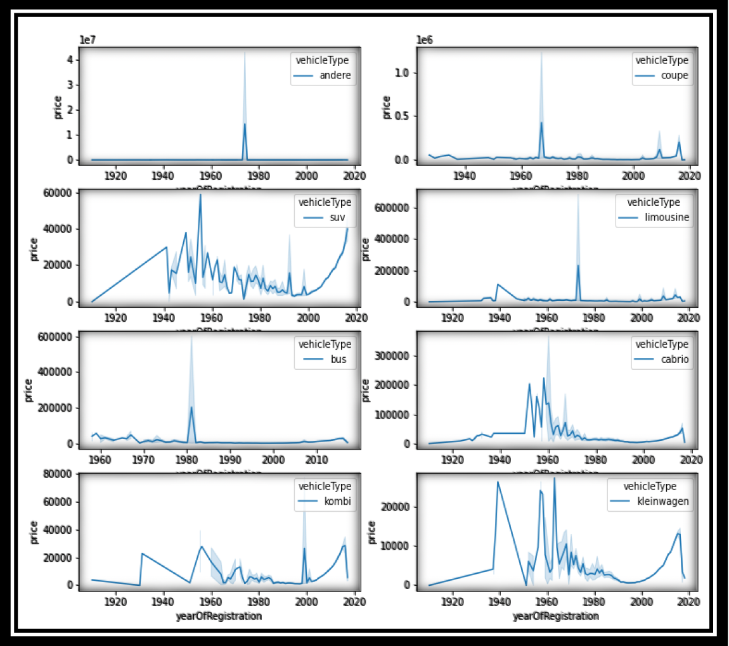
Price VS Year
Among all the years, Andere has highest price range in year 1970.
SUV, Ide in Wagen, Cabriolet and Kombi had constant change in their price range from 1920 to 2020.
Coupe and Limousine have their prices changed very few times compared to other vehicle types.

Slide 9
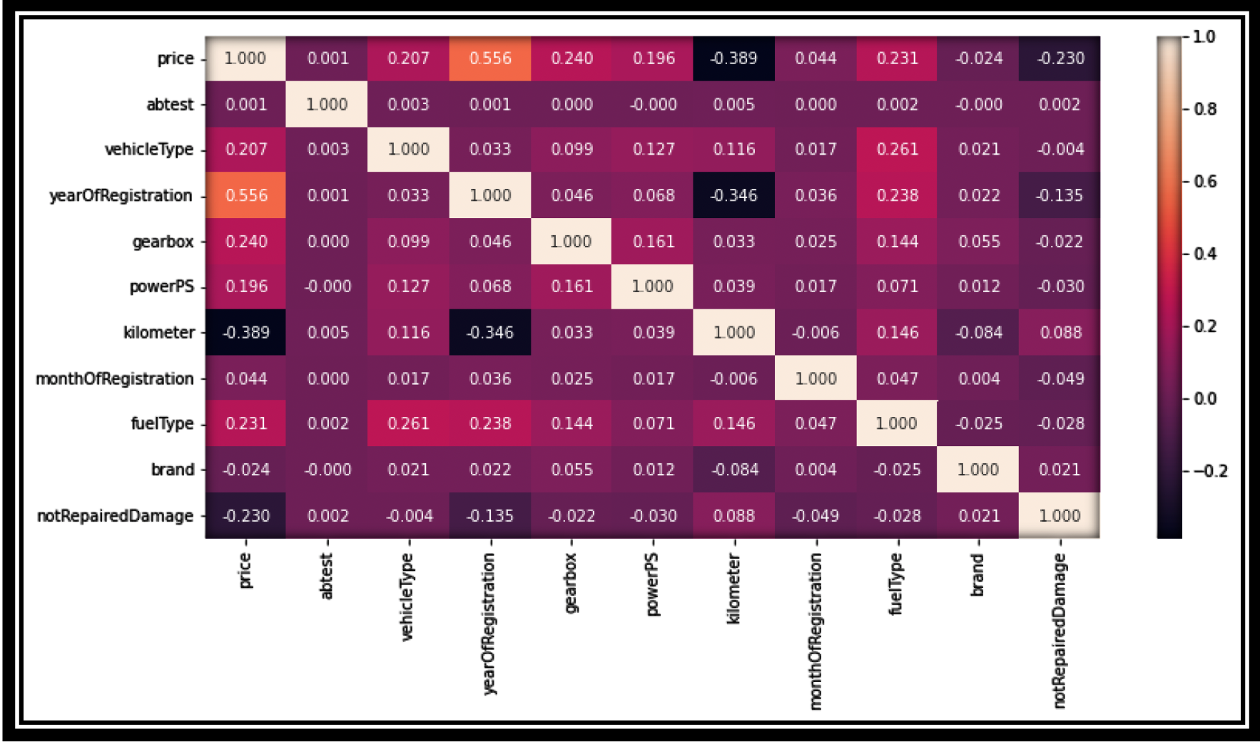
Correlation Matrix
Price and Year of Registration have a positive correlation.
Kilometers and Price have a negative correlation.
Overall, there is relatively little correlation among the variables.

Slide 10
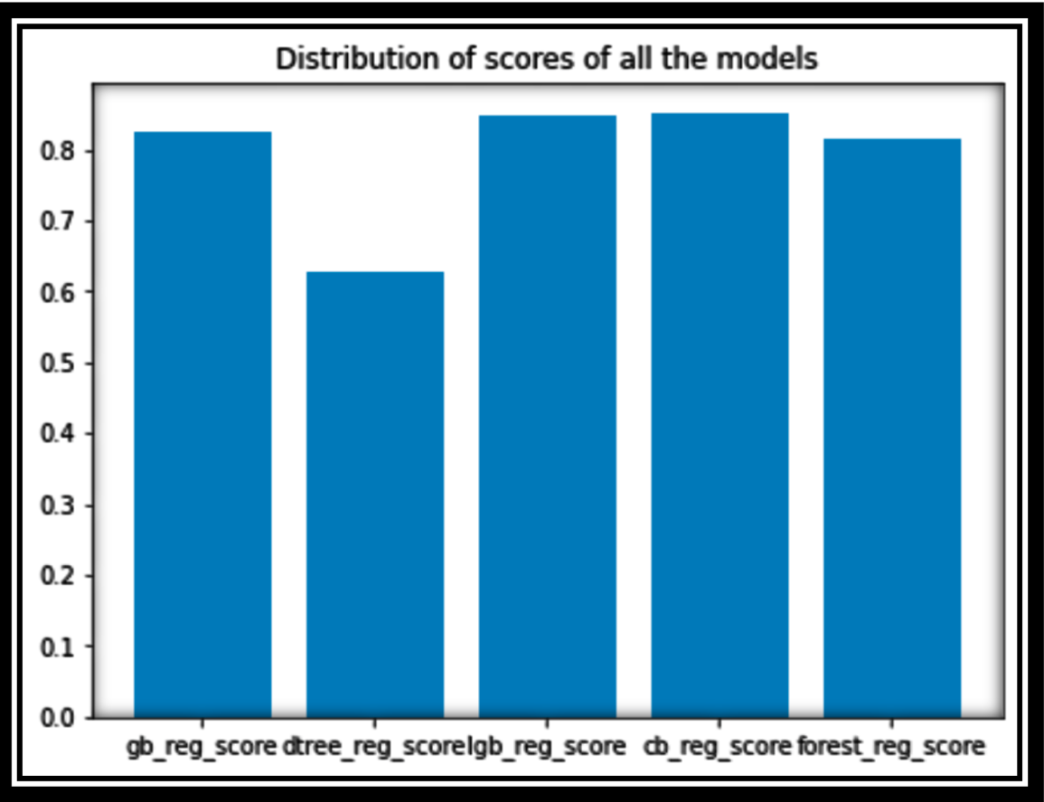
Regression Modeling
SKLearn standarscaling has been applied.
The catboost model achieved the highest accuracy of 85%, followed by the lightGBM model at 84%, and the GBM model at 82%.
{'gb_reg_score': 0.8240325077840415, 'dtree_reg_score': 0.6276140598166777, 'lgb_reg_score': 0.8483367030093877, 'cb_reg_score': 0.8512830000988931, 'forest_reg_score': 0.8148905677453715}
n_estimators=200, criterion='squared_error', random_state=1, learning_rate=0.1, max_depth=None

Slide 11
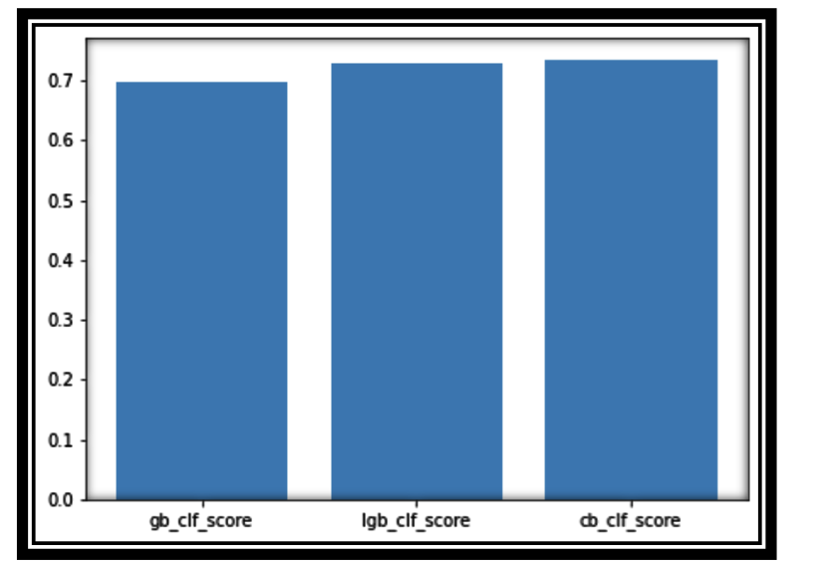
Classification Modeling
SKLearn standarscaling has been applied.
A type of machine learning technique used to predict the categorical (discrete) variable of a given observation based on its features or attributes.
"vehicle type" attribute is the target variable used to perform classification.
CatBoost achieved highest accuracy of 73% among the boosting classifier Models.
n_estimators=200, criterion='squared_error', random_state=1, learning_rate=0.1, max_depth=None

Slide 12
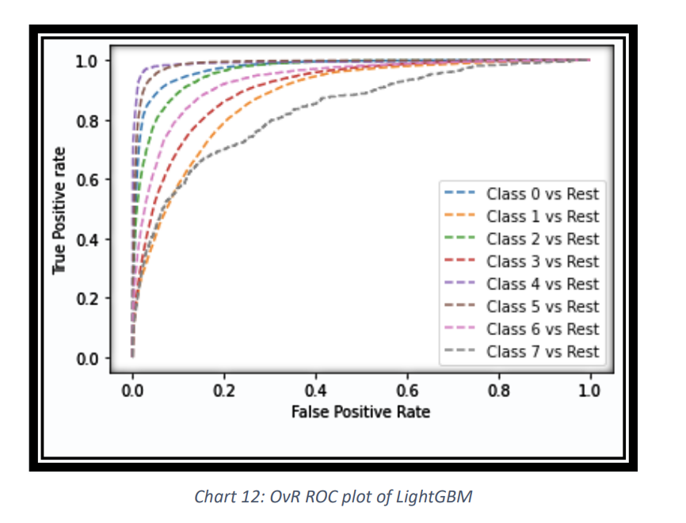
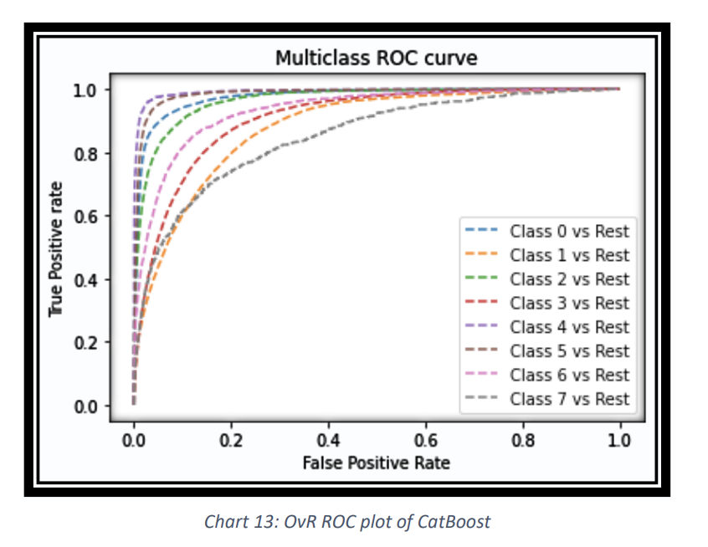
Performance comparison -CatBoost VS LightGBM
The CatBoost classifier model achieved the highest auc-roc-score of 93.7% while the LightGBM achieved 93.3%.
Metrics used to evaluate the performance of a classification model: Precision,Recall and ROC curve.

Slide 13
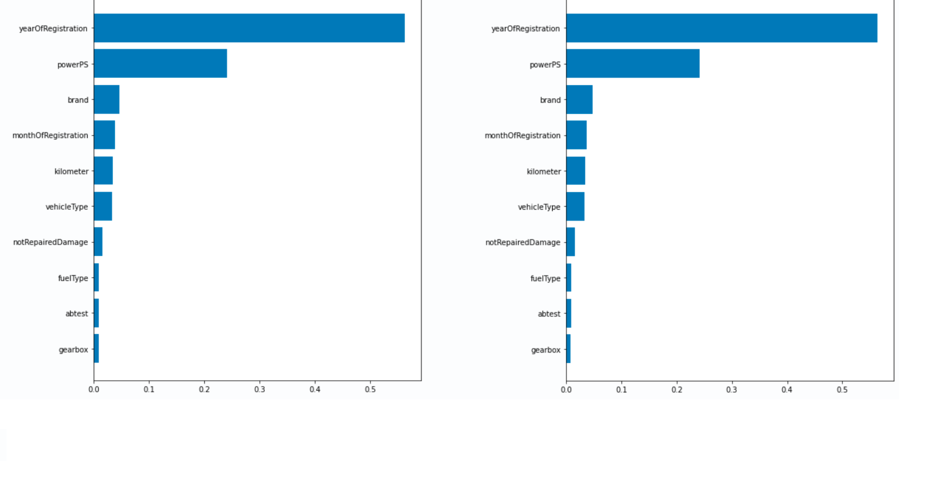
Feature importance graphs
The graphs suggest that the year of Registration and powerPS are the most important features in the model's prediction.

Slide 14
Conclusion
We look forward to extending this work further by exploring the features dateCrawled, abtest, vehicleType as we believe they have more potential to improving the model performance. This work can be used in the near future to estimating the car prices accurately by addition of updated data. More attributes can be added such as the description of the cars which acts as an added bonus to understanding the condition of the car more intuitively.
🙏

